Slide 1
Classification Study : eThekwini Municipality
Perspective :
Introduction to eThekwini Study
Bill.pfaff@durban.gov.za

Slide 2
Aims and Objectives of DWA Classification Study
Classification study will define an agreed level of ecological protection for a water resource ( ie river / estuary) via a ‘management class’.
This ‘Management class’ regulates, inter alia, the quality and quantity of treated sewage effluent ( ie wastewater ) that can be disposed of to river/estuary
Management class is a ‘balance’ between ecological , social and economic uses of the water resource
This ‘balance’ will be achieved by assessing the costs and benefits associated with utilization, versus those associated with the protection, of the particular water resource

Slide 3
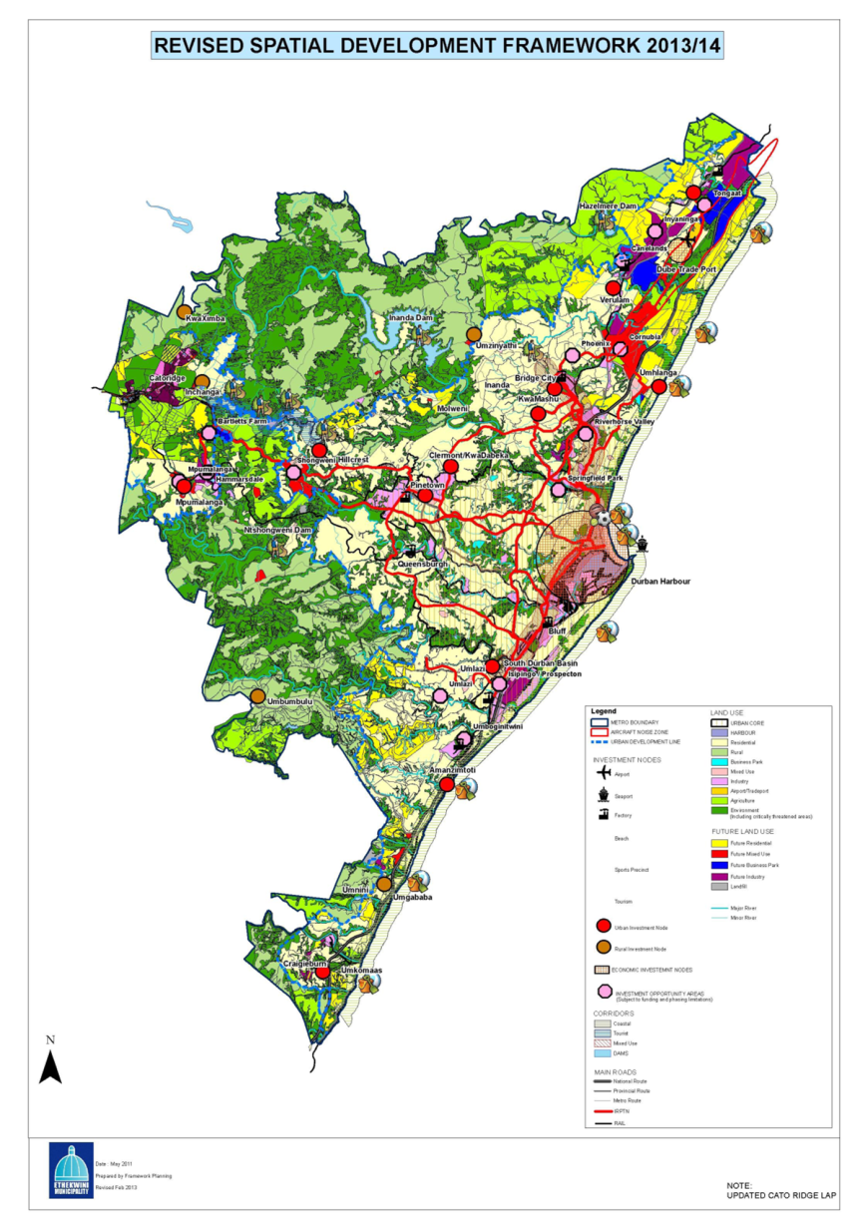
Revised Spatial
Development
Framework
2013/14

Slide 4
eThekwini Study
Development will double the water demand/ double overall volume of treated wastewater with development in the less developed catchments
eThekwini funded study will investigate long term strategic wastewater disposal options – against a backdrop that the existing releases of wastewater to some estuaries are having / or will have , a negative impact.
Conducted in partnership with DWA ,will add to and compliment the DWA study, and will use the same specialist study team

Slide 5
Study aims to
Add to the confidence of the current reporting by limited, but focussed, monitoring – aim is to compliment the more extensive monitoring by DWA
“…… seriously hampered by lack of long term monitoring data”
“…. water quality conditions cannot be resolved with any degree of confidence “
Unpack options , per catchment , for treatment and disposal of wastewater that align to the Classification process
Obtain agreement on the option which provides the appropriate balance between protection and the means of wastewater disposal

Slide 6
Options : Mitigation measures and Trade-Offs
Mitigation
Improve effluent quality ( nutrient removal)
Review dam release policies and implementation
Removal of anthropogenic impacts ( illegal causeways, infilling of wetland etc … )
Cross-catchment pumping ( Mhlanga to Mgeni : Mdloti to Hazelmere dam … )
Discharge to a marine outfall
Re-use of wastewater to potable water
Trade – Off
An acceptance of a reduction in ecological category in one estuary where an adjacent estuary or estuaries is maintained or improved

Slide 7
Objective of Study
To inform the process which provides the appropriate Balance between cost of a mitigation measure vs the ecological benefit
Ohlanga to Mgeni pumping scheme :CAPEX R30 mill. OPEX R 3mill pa
New marine outfall R300 mill. ????
To develop an agreed means for the disposal of wastewater from each catchment which aligns with the ‘classification’.
To pave the way for “license “ approvals
To form the basis of a long term sewage disposal plan for eThekwini which facilitates the S D F

Slide 8
Estuaries in eThekwini
16 estuaries ( out of 64 in DWA study area )
8 impacted on by existing or future disposal of wastewater
Umkomazi ; Durban Harbour : Mgeni excluded from study
South : Mbokodwini / Litte Manzimtoti
North : Mhlanga / Mdloti / Tongati
Invitation to join focussed stakeholder teams ;
South : Rob Dyer
North : John Harrison

